Slide 1
Support Vector Machines
Tim Smith, PhD

Slide 2
Support Vector Machines
Very popular
Powerful for both classification and regression
Can uncover both linear and nonlinear relationships!
Resource intensive!

Slide 3
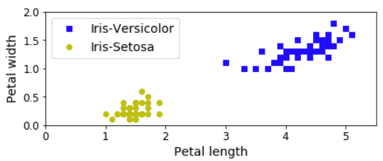
Linear SVM Classification
Iris data: separate one class from the other

Slide 4
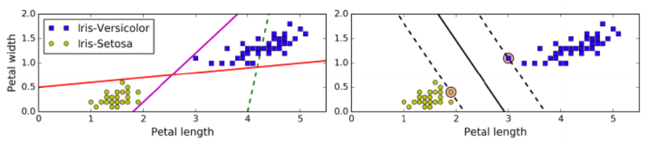
Linear SVM Classification
Iris data: separate one class from the other
Support vectors
Goal: fit the widest possible "street" between classes
Decision boundary (stays as far away as possible from instances)

Slide 5
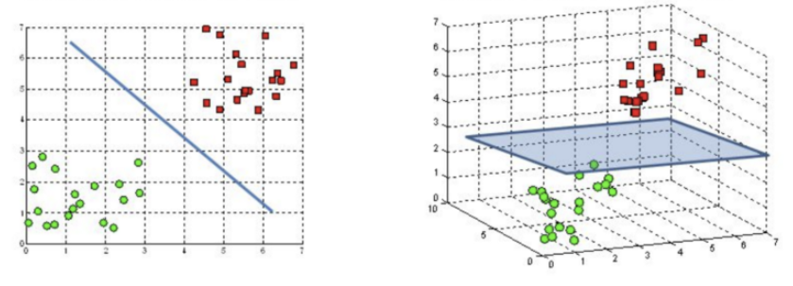
Linear SVM Classification
Hyperplanes: separate one class from another
In a 2-D world, the hyperplane is a "line"
In a 3-D world, the hyperplane is a "plane"
Image source: https://towardsdatascience.com/support-vector-machine-introduction-to-machine-learning-algorithms-934a444fca47

Slide 6
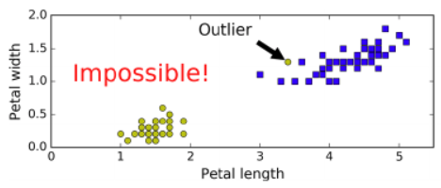
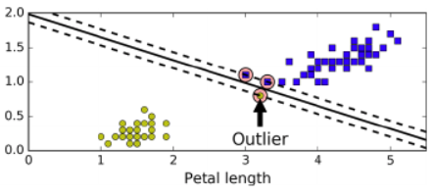
Hard Margin Classification
Example 2
Data must be linearly separable
There must be NO outliers
(i.e., the perfect world!)
Example 1
Example 3

Slide 7
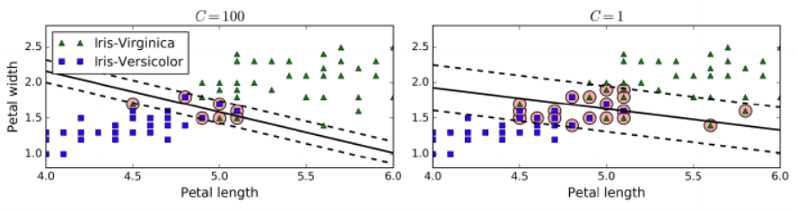
Soft Margin Classification
Allows margin violations
Instances that are "in the street" or "misclassified"
C is referred to as “regularization parameter”
Controls the width of the margin
Determines how much violation is allowed!
Higher C values perform LESS regularization
Leads to a SMALLER margin
Aims for less violations
There is a risk of overfitting
Lower C values perform MORE regularization
Leads to a WIDER margin
Aims for more violations
Favors generalizability

Slide 8
Nonlinear SVM Classification
Not all data are linearly separable
Solution 1:
Create polynomial features manually and fit a linear SVM!
Problem: Generates too much data (so needs more resources!)
(Example on next slide)

Slide 9
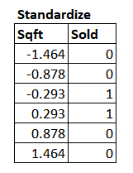
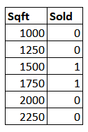

Nonlinear SVM Classification
Example

Slide 10
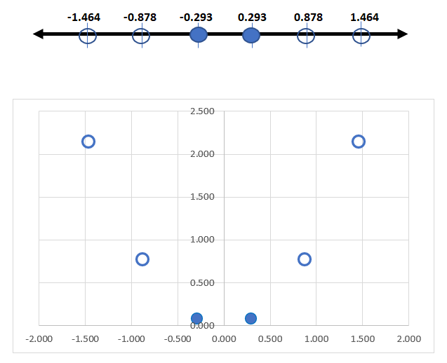
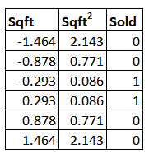
Nonlinear SVM Classification
Example

Slide 11
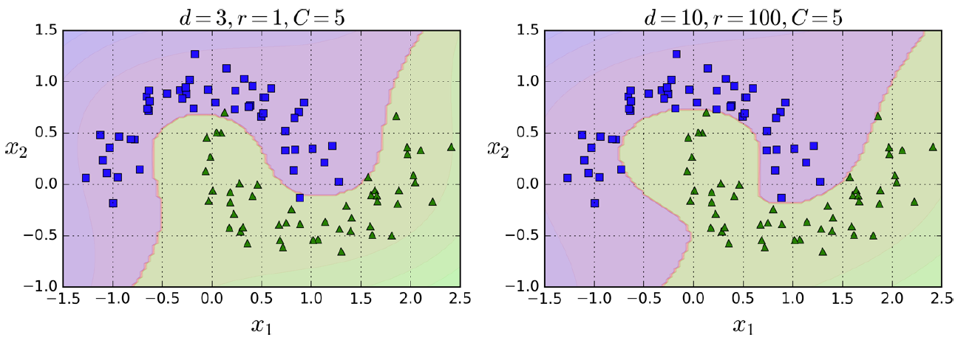
Nonlinear SVM Classification
Solution 2: use a "kernel trick"
Similar to adding many polynomial degrees; but it’s only calculated and the data is not actually altered by adding new polynomial features.
SVC(kernel="poly", degree=3, coef0=1, C=5)
coef0 controls how much the model should be influenced by higher degree polynomials
d=3, coef0=1, C=5
d=10, coef0=100, C=5

Slide 12


Adding Similarity Features
Another technique to tackle nonlinear classification
Adds "features" (i.e., new variables/dimensions) for separation of instances
Computationally expensive
x3
x2
x1

Slide 13
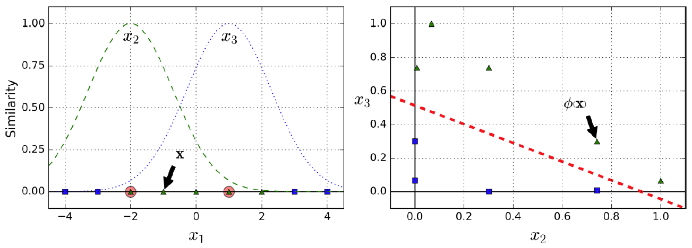
Gaussian RBF Kernel
The kernel trick to add similarity features
Gaussian Radial Basis Function
Landmarks

Slide 14
Gaussian RBF Kernel
SVC(kernel="rbf", gamma=5, C=0.001)
Higher gamma makes the bell shape narrower
Smaller gamma makes the bell shape wider
Increase gamma if the model is underfitting!
Decrease gamma if overfitting!

Slide 15
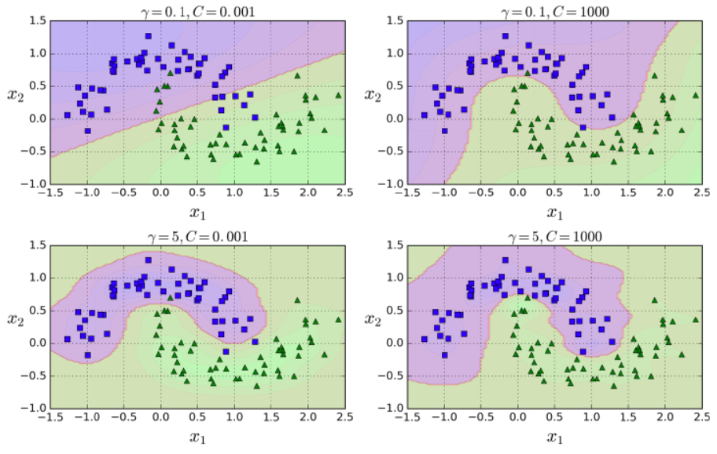
Gaussian RBF Kernel
Increase C to minimize violations
Increase gamma to address underfitting

Slide 16
Kernel Tricks
SVC(kernel="linear")
Fits a straight line/plane to separate the two classes
SVC(kernel="poly")
Tricks the SVC to think that there are polynomial features (WITHOUT creating polynomial features)
Fits a curved line/plane to separate the two classes
SVC(kernel="rbf")
Tricks the SVC to think there are new features (i.e., similarity features)
Fits a straight line/plane in a new n-dimensional space

Slide 17
Multi-Class Classification
SVM cannot perform multi-class classification (in its true sense)
Instead, it performs: one-versus-rest ("ovr")
Create multiple binary class classification models
Run the observation on these models
Make a final determination based on the combined results

Slide 18
OvR
Logistic and SVM use this encoding in the background.
One-vs-rest is a method for using binary classification algorithms for multi-class classification.
OvR approach splits the multi-class dataset into multiple binary classification problems.
Example: Predicting red, blue, green or yellow:
Binary classification problem 1: red vs [blue, green, yellow]
Binary classification problem 2: blue vs [red, green, yellow]
Binary classification problem 3: green vs [red, blue, yellow]
Binary classification problem 4: yellow vs [red, blue, green]
A binary classifier is then trained on each binary classification problem and predictions are made using the model that is the most confident.

Slide 19
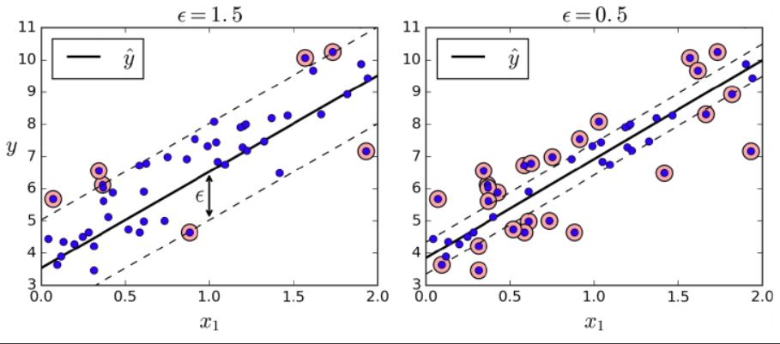
SVM Regression
SVM can be used to predict numerical values too
Instead of creating the widest street, fits most instances on the street
The width of the street is controlled by epsilon

Slide 20
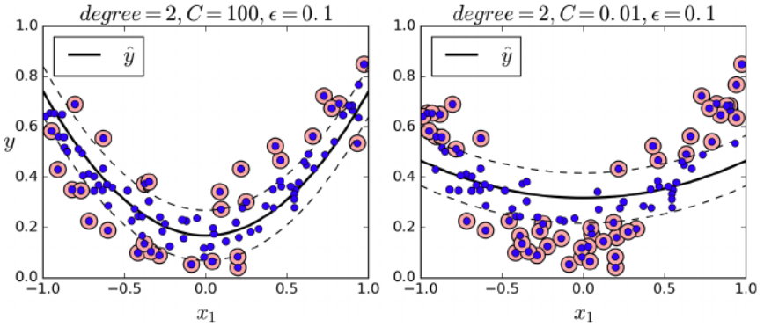
SVM Regression
Use kernelized SVM for polynomial models

Slide 21
Python Cheatsheet
C: regularization
Small C: wide margin, allows more violations (i.e., generalizable)
High C: small margin, allows less violations (i.e., overfitting)
coef0: used for poly kernel
Controls how much the model is influenced by higher degree polynomials
gamma: the shape of the bell for Gaussian RBF
Higher values make it narrower
Smaller values make it wider
tol: precision parameter
epsilon: width of the margin in regression
See:
https://scikit-learn.org/stable/modules/svm.html

